Slide 1
IMPLEMENT SCHEDULING ALGORITHMS OF OPERATING SYSTEM
Submitted By:- 18BCE011
18BCE040
18BCE008

Slide 2
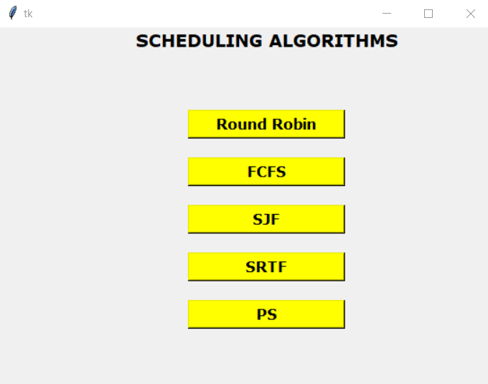
IMPLEMENTED SCHEDULING ALGORITHMS
1. Round Robin
2. First Come First Serve
3. Shortest Job First
4. Shortest Remaining Time First
5. Priority Scheduling

Slide 3
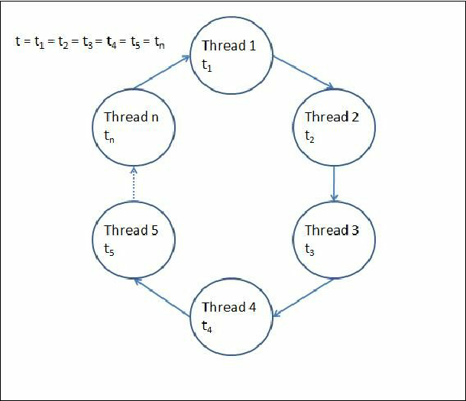
1.ROUND ROBIN
Round Robin is a CPU scheduling Algorithm where each process is assigned a fixed time slot/time quantum in a cyclic manner.
We take Arrival time, Burst time And Time Quantum as an input for 5 processes.
Advantage: Starvation does not occur
Disadvantages: Throughput depends on the time quantum
We can’t give the priority to the processes

Slide 4
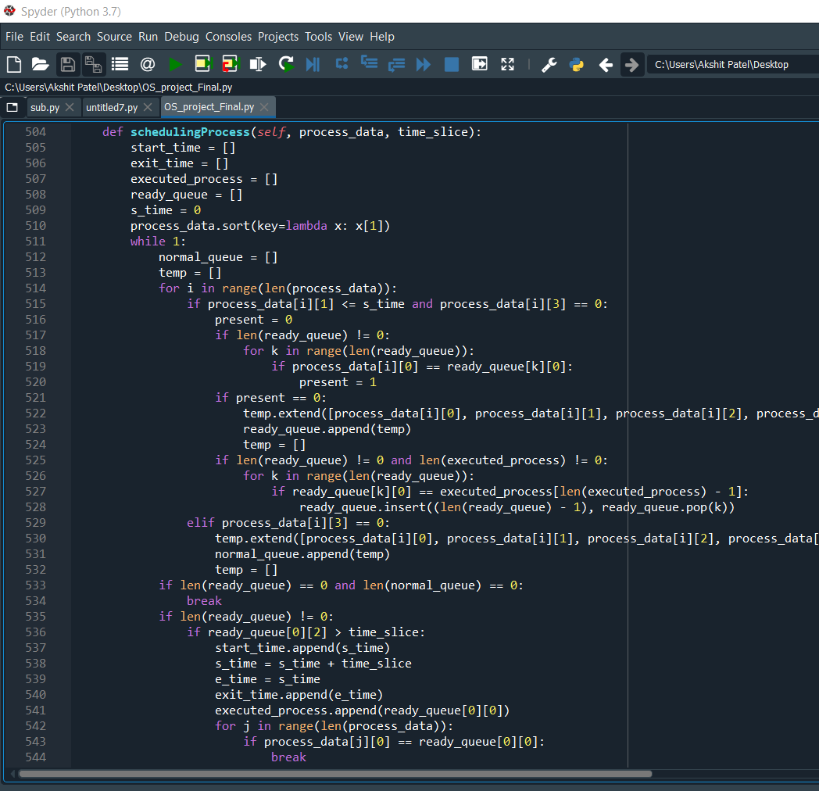
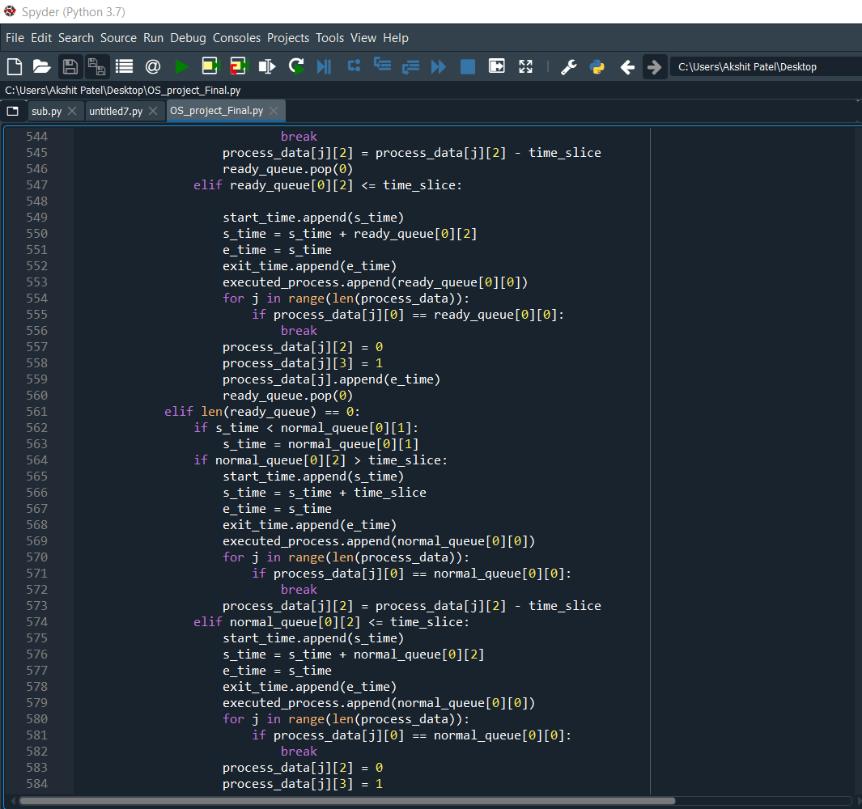
ROUND ROBIN (CODE SEGMENT)

Slide 5
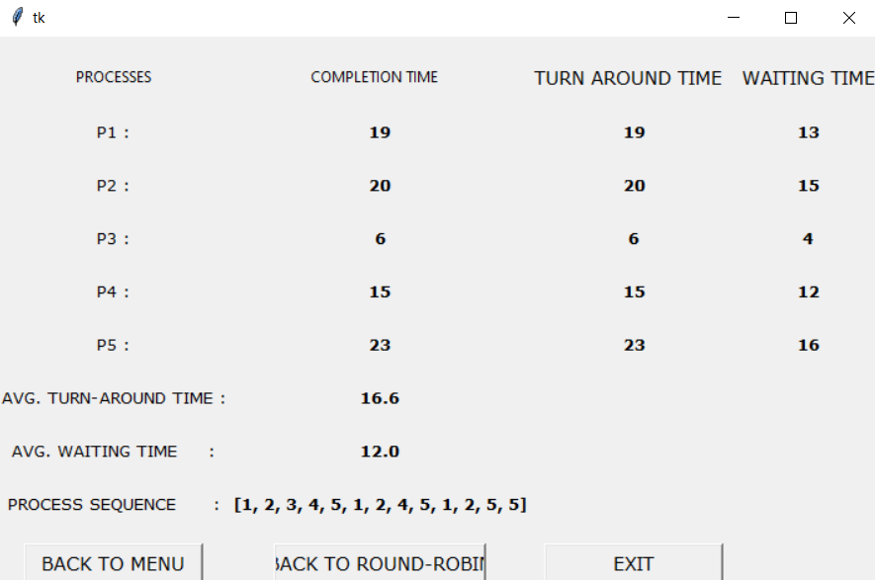
EXAMPLE OF ROUND ROBIN

Slide 6
2.FIRST COME FIRST SERVE
Processes are executed on the basis of their arrival time means on the basis of first come first serve.
It is non-preemptive scheduling algorithm and it’s implementation is based on FIFO queue.
Advantages:- It is easy to implement.
Disadvantages:- 1. Average waiting time is not optimal.
2. It does not understand the priority of processes.
3. It exhibits convey effect which lower downs the CPU or I/O utilization execution of one big process the other short processes have to wait for long.

Slide 7
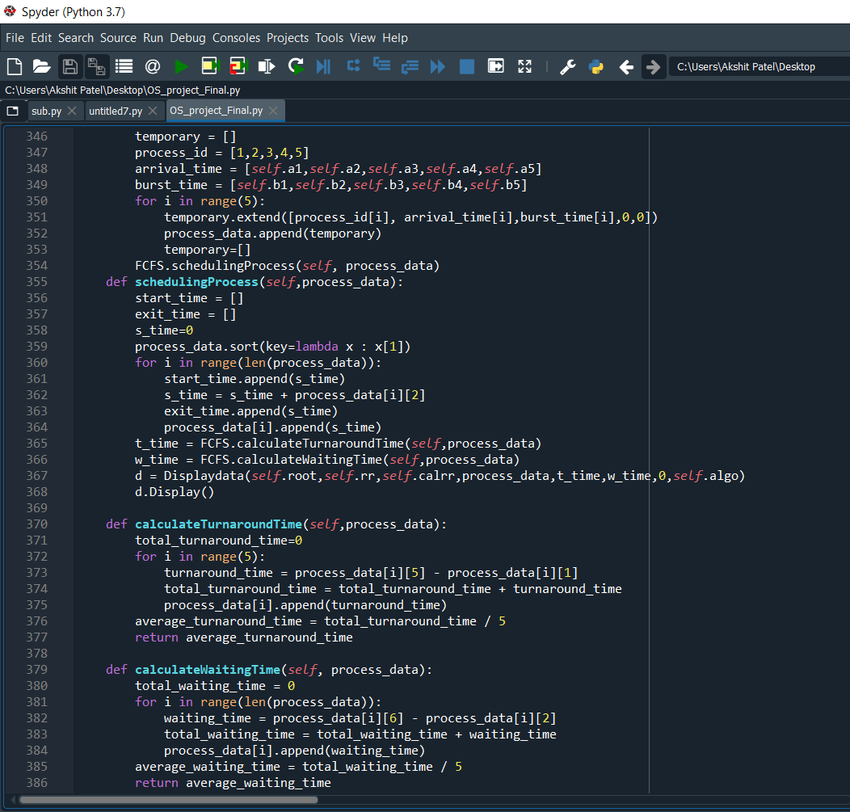
FIRST COME FIRST SERVE (CODE SEGMENT)

Slide 8
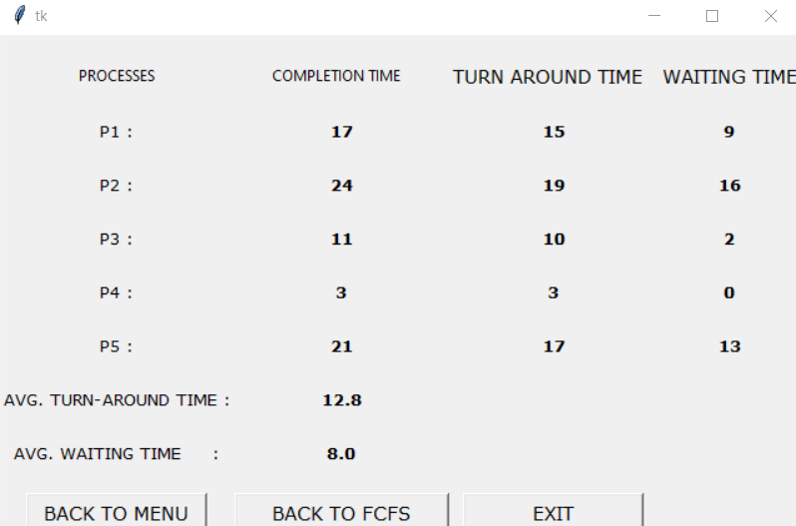
EXAMPLE OF FCFS

Slide 9
3.SHORTEST JOB FIRST
It is an algorithm in which the process having the smallest execution time chosen for next execution.
It is non preemptive in nature.
Advantages:- it reduces the average waiting time over FIFO algorithm.
Disadvantages:- This algorithm may cause starvation.

Slide 10
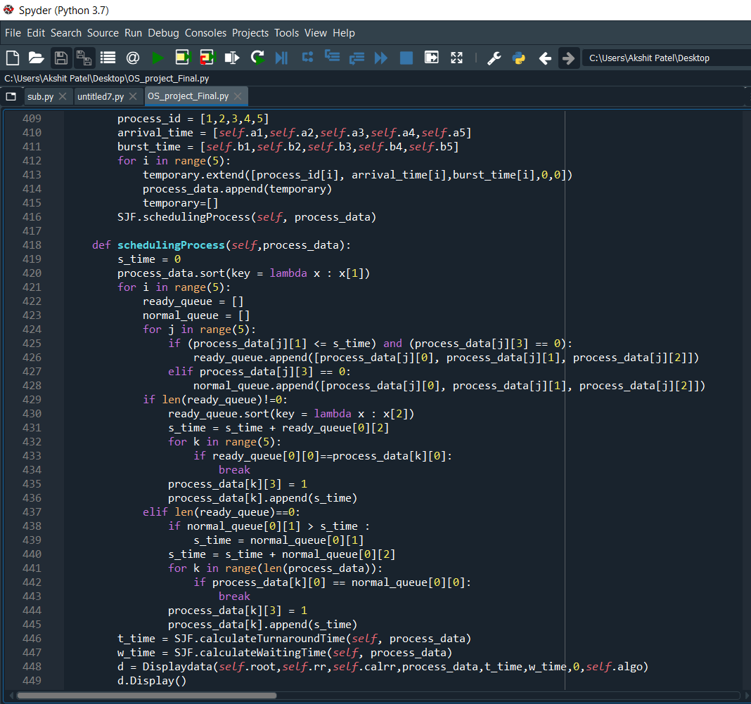
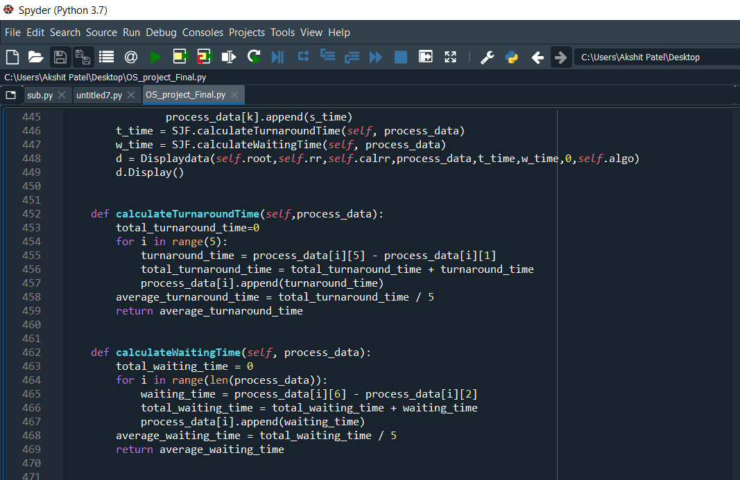
SHORTEST JOB FIRST (CODE SEGMENT)

Slide 11
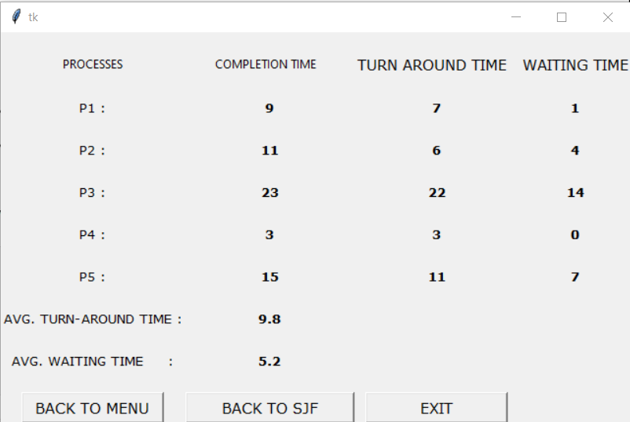
EXAMPLE OF SJF

Slide 12
4. SHORTEST REMAINING TIME FIRST
It is preemptive version of Shortest Job First.
In this the process with the smallest amount of time remaining until completion is selected to execute.
It is rarely used because it requires accurate estimates of the runtime of each process.

Slide 13
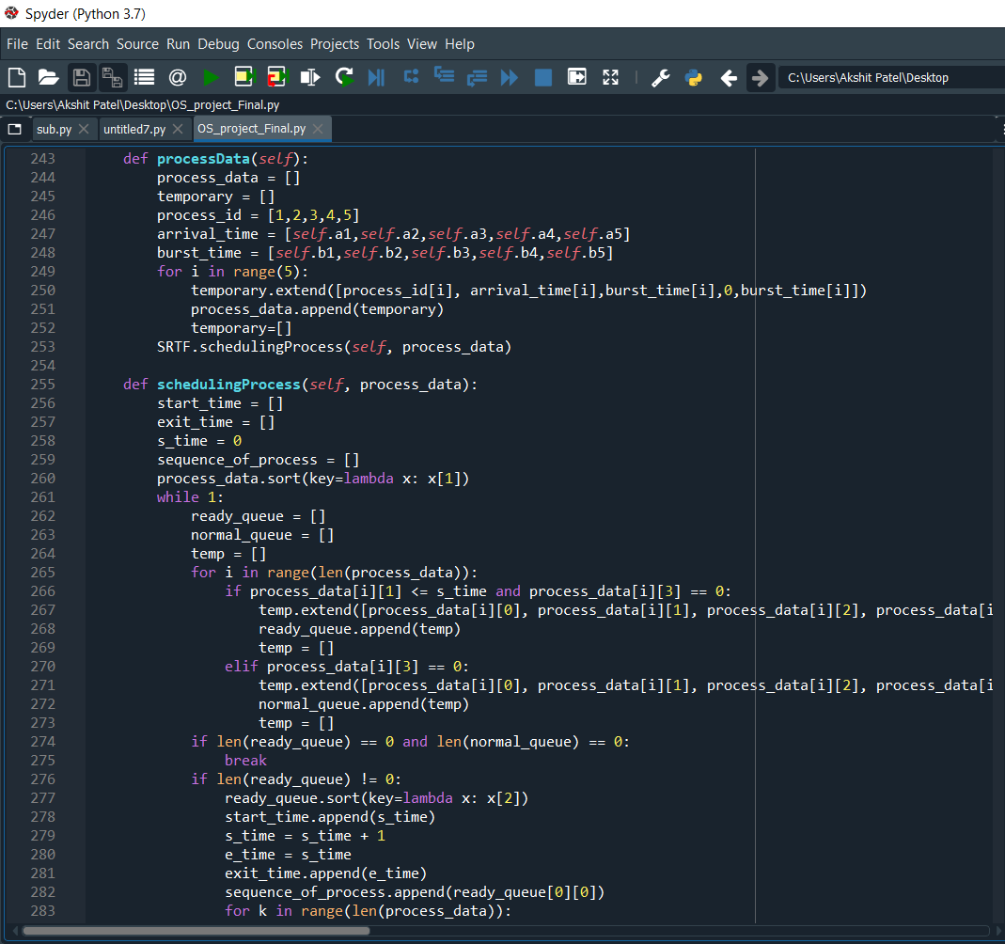
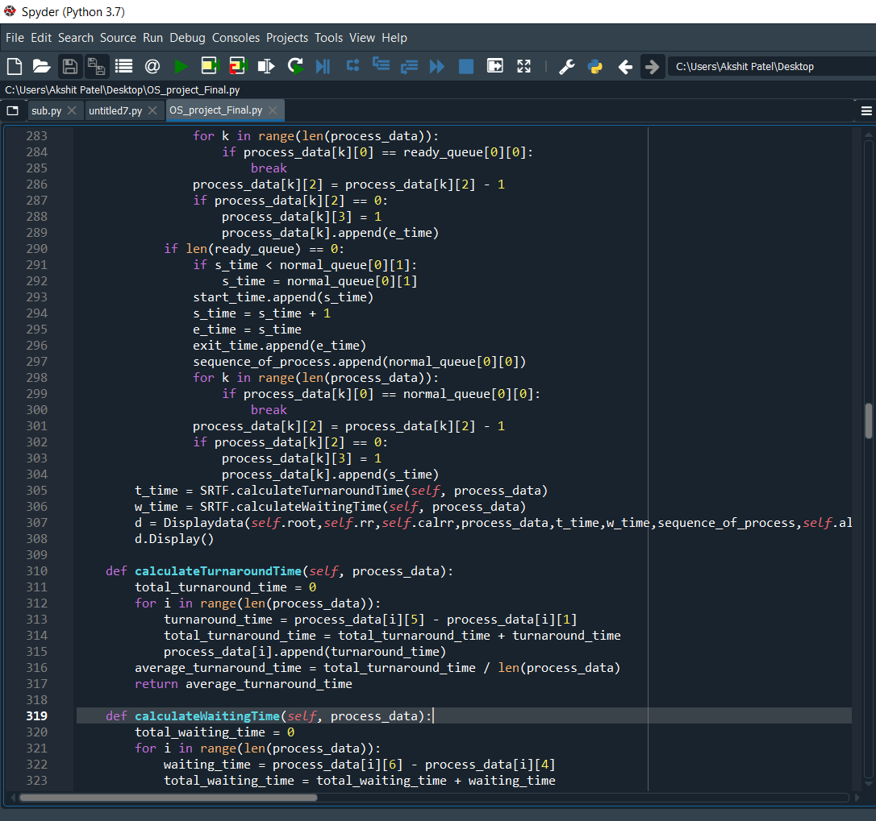
SHORTEST REMAINING TIME FIRST (CODE SEGMENT)

Slide 14
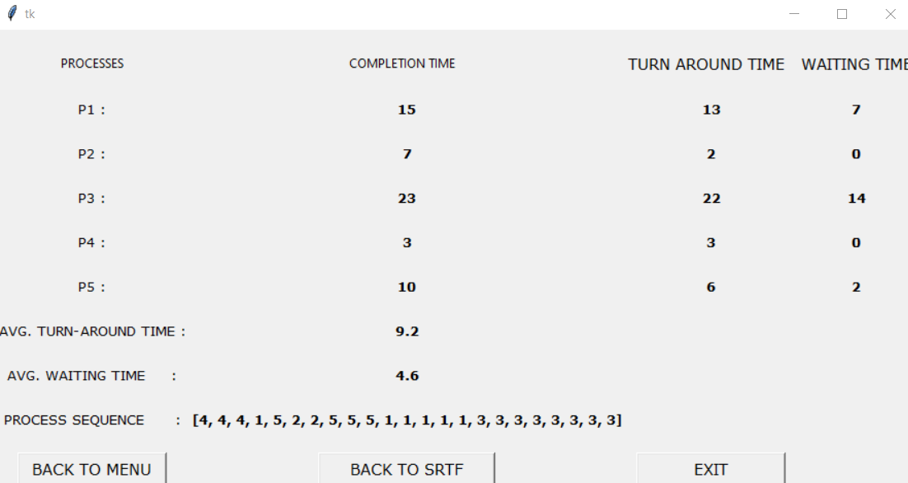
EXAMPLE OF SRTF

Slide 15
5. PRIORITY SCHEDULING (NON PREEMPTIVE)
It is a method of scheduling processes on the basis of their priority means the processes with higher priority should be carried out first
The main problem is that there will occur starvation if higher priority processes coming continuously so, there lower priority process will never get chance to execute.
We can solve this problem by aging means we will increase the priority of the process as time progresses.

Slide 16
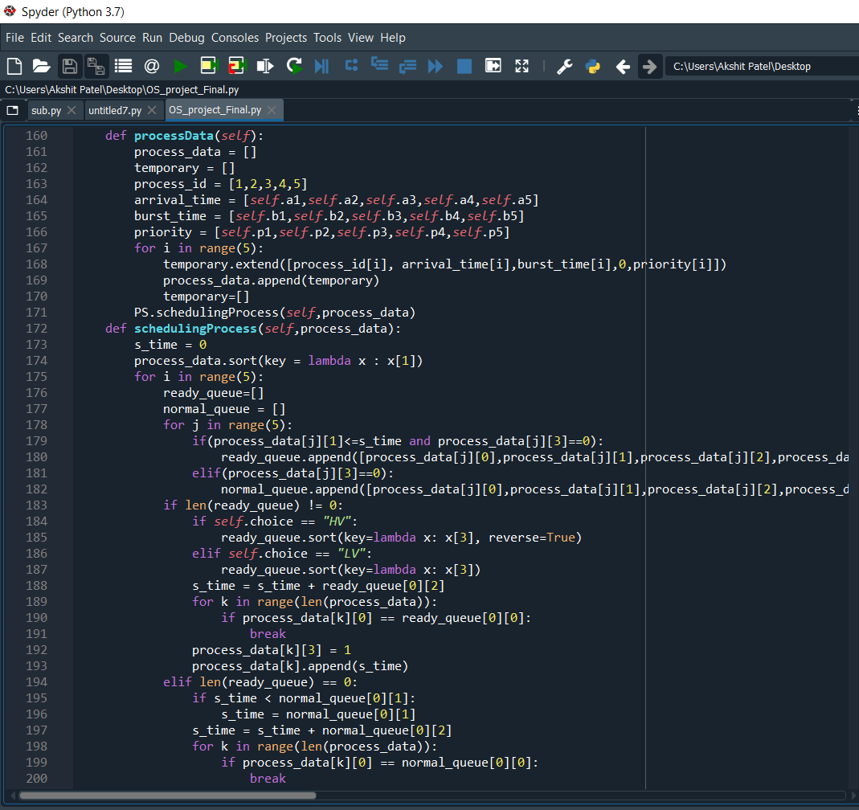
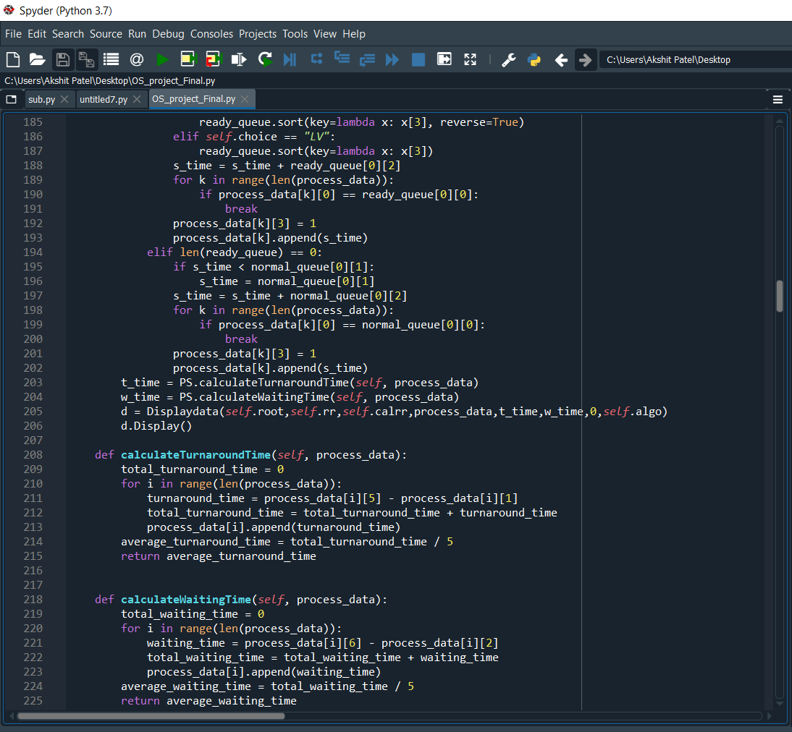
PRIORITY SCHEDULING (CODE SEGMENT)

Slide 17
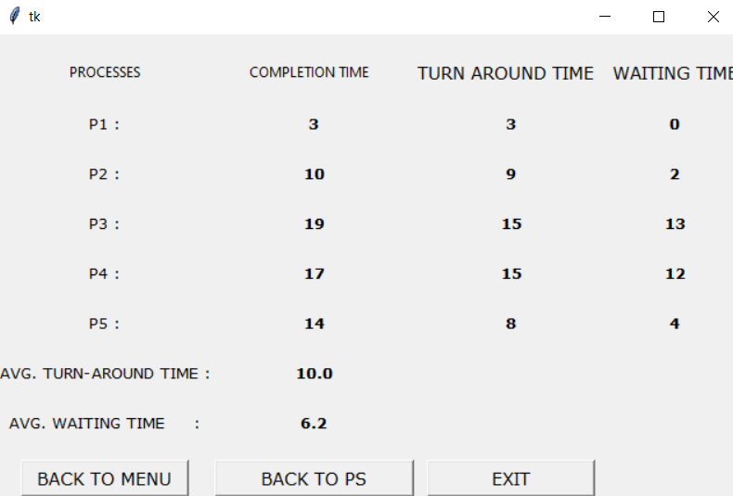
EXAMPLE PRIORITY SCHEDULING

Slide 18
THANK
YOU

